Slide 1
Java Project
Team no : 8
Outputs and tables

Slide 2
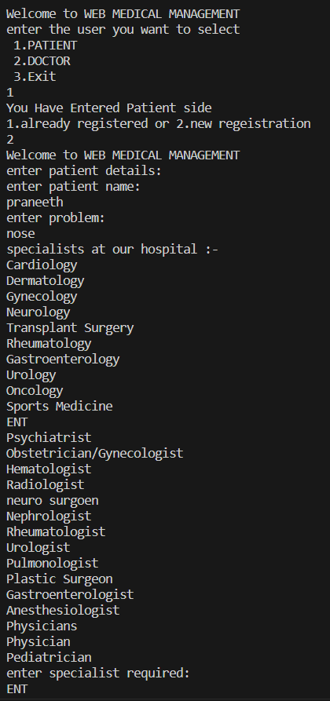
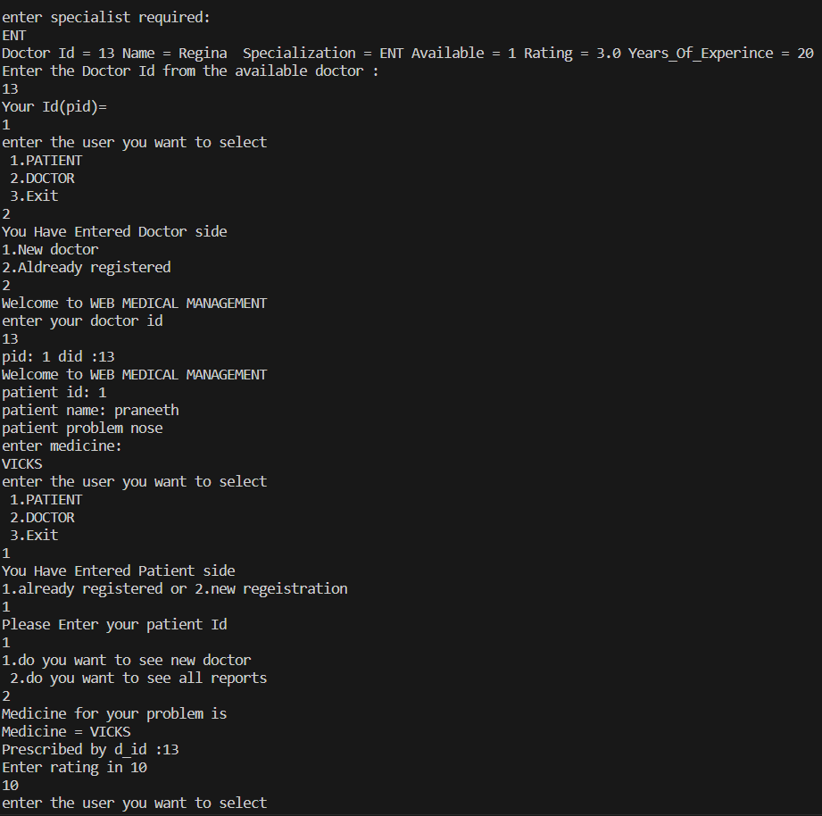
OUTPUT 1:Seamless Output

Slide 3
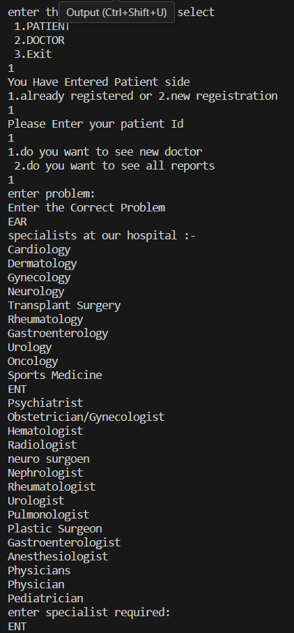
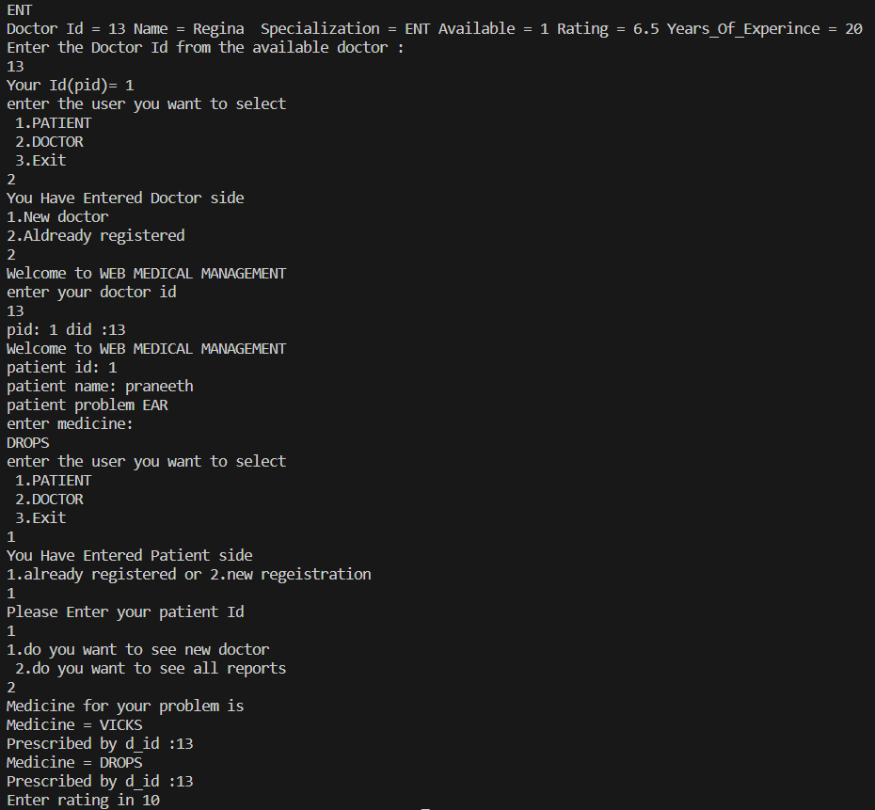

Slide 4
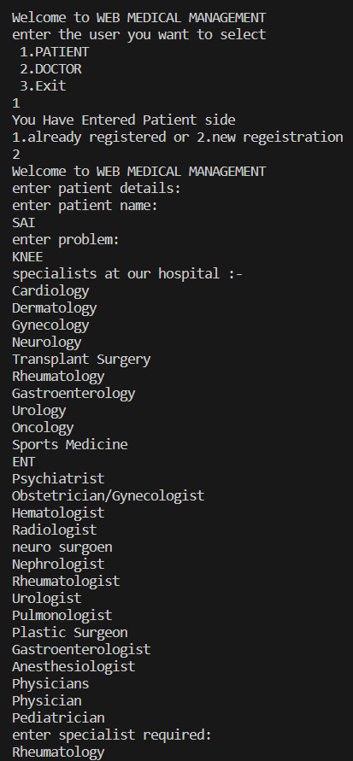
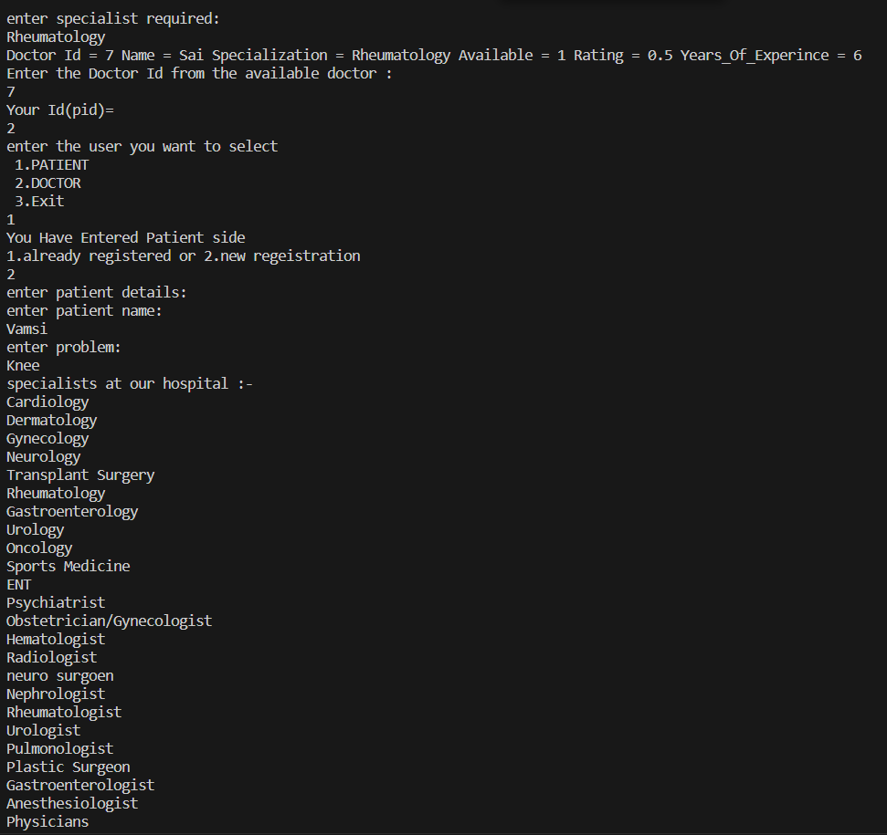
OUTPUT 2: When the Doctor is Busy

Slide 5
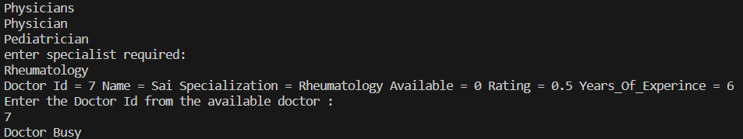

Slide 6
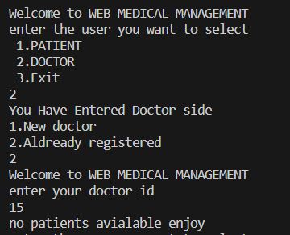
Output : 3 When There is no Patient Appointed for a Doctor

Slide 7
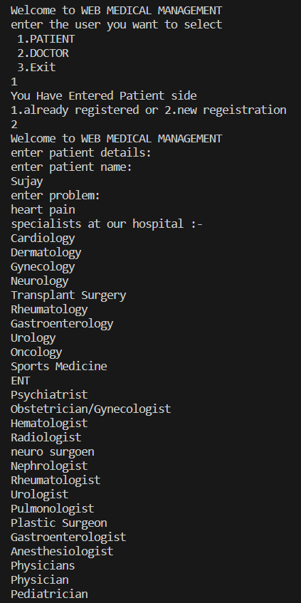
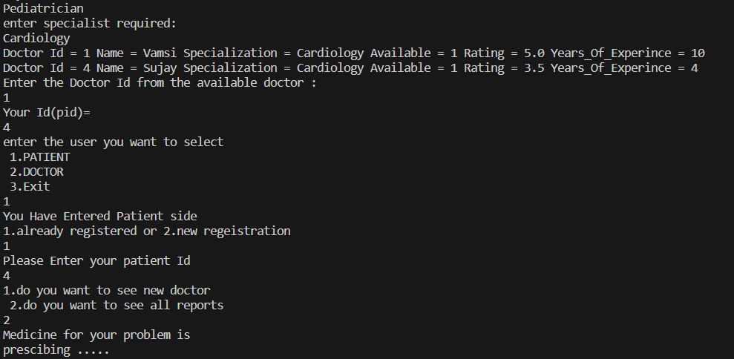
Output : 4When a Patient enters before the doctor Prescribed the Medication

Slide 8
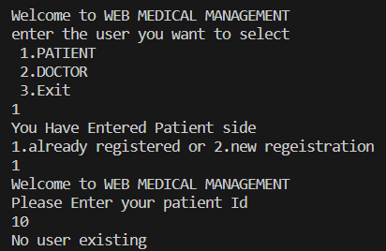
Output : 5 Patient without Registration

Slide 9
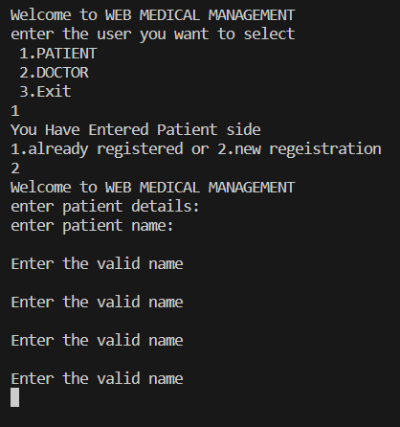
Output : 6 Patient without a valid Name

Slide 10
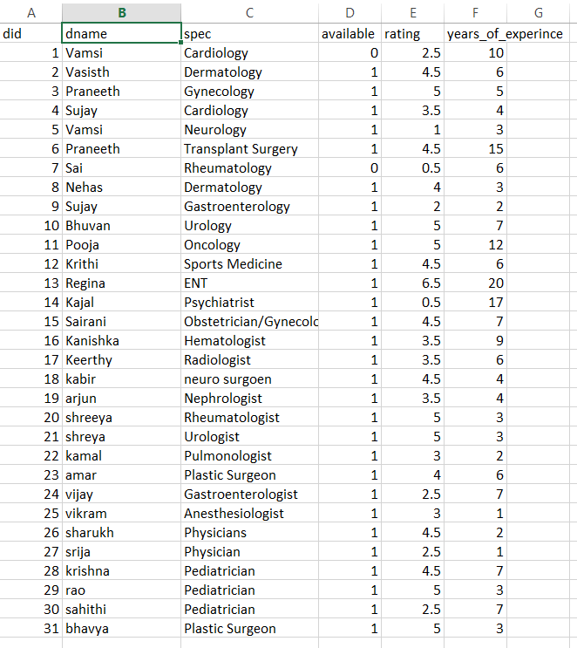
Doctor Table:

Slide 11
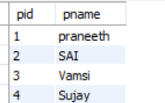
Patient Table :

Slide 12
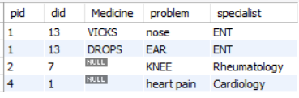
Treatment Table:

